Slide 1
Design and Analysis of Algorithms
Algorithms-II : CS345A
Lecture 9
Proof of Correctness: Synchronzing the circuit problem
Huffman Codes

Slide 2
Recap of the last lecture

Slide 3
Synchronizing a circuit
with minimum delay enhancement

Slide 4

Claim :
There is an optimal solution where,
the delay enhancement by $u$ = |$D_{R}(u){−D}_{L}(u)$|

Slide 5

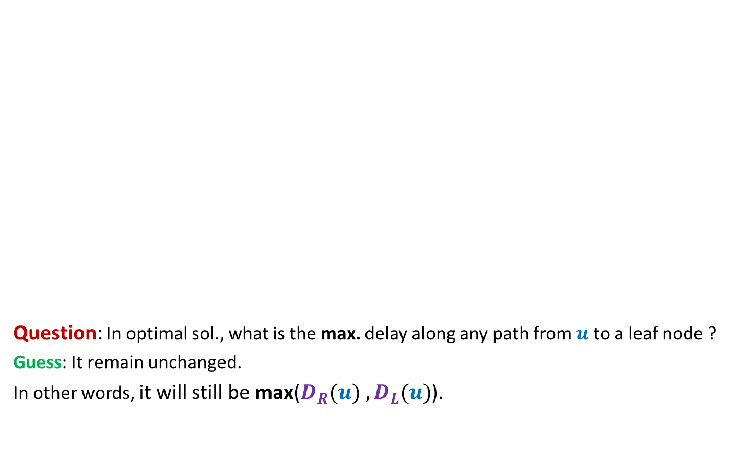
Observation 2
The maximum delay from the root to any leaf node remains unchanged in the optimal solution. What can we say about the maximum delay from any other node to any leaf node in its subtree?
Electric signal
Question: In optimal sol., what is the max. delay along any path from $u$ to a leaf node ?
Guess: It remain unchanged.
In other words, it will still be max($D_{R}(u){ ,D}_{L}(u)$).
$$u$$
6
5
+3
3
+3
2
4
2
+1
2
6
+4
1
1
2
+1
3
2
+1
+1
2
Delay 11 10 14 10 10 11 10 9
New Delay 14 14 14 14 14 14 14 14

Slide 6

Proving the guess
Guess : In the optimal solution, the delay along any path from $u$ to any leaf node is max($D_{R}(u){ ,D}_{L}(u)$).
Question: How to prove it ?
Answer: By contradiction.

Slide 7

What if the assertion fails at many nodes ?
Consider the lowest node in the tree where it fails.
In particular, any node with no red descendant will suffice.
(can you see why it is difficult to analyze any other “red” nodes ?)
$$u$$

Slide 8
What if the assertion fails at many nodes ?
$$u$$

Slide 9



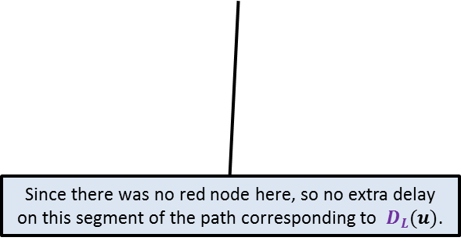


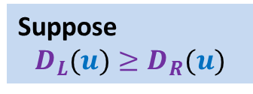



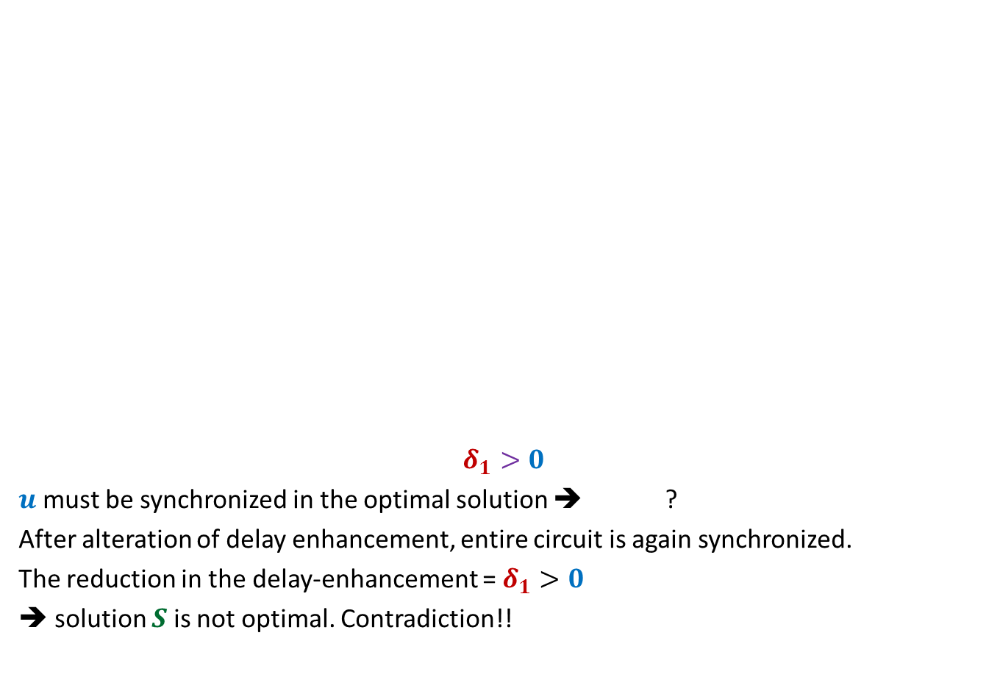













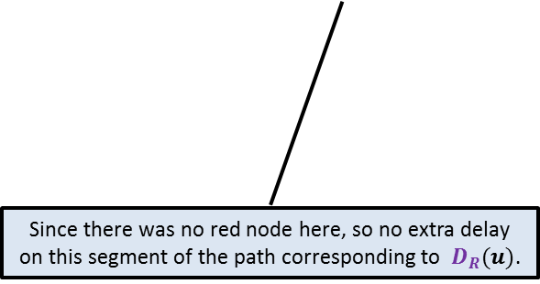
Proof:
the maximum delay on any path from $u$to any of its leaf node
is strictly greater than $D_{L}(u)$in an optimal solution $S$.
Suppose
$$D_{L}(u)≥D_{R}(u)$$
What does it imply ?
$$γ$$
$${+δ}_{3}$$
Can you do some manipulation to reduce the total delay enhancement ?
$$γ$$
What does it imply ?
$${+δ}_{3}$$
$${+δ}_{1}$$
$$u$$
$$u$$
$$δ_{1}>0$$
$u$ must be synchronized in the optimal solution ➔ ?
After alteration of delay enhancement, entire circuit is again synchronized.
The reduction in the delay-enhancement = $δ_{1}>0$
➔ solution $S$is not optimal. Contradiction!!
$$α$$
$${+δ}_{1}$$
$$β$$
$${+δ}_{2}$$
$$α$$
$$β$$
$${+D}_{L}\left(u\right)\text{ − }D_{R}\left(u\right)$$
$$+δ_{2}−δ_{1}$$
$$D_{L}(u)$$
$$D_{R}(u)$$
$$D_{L}(u)$$
$$D_{R}(u)$$
Since there was no red node here, so no extra delay on this segment of the path corresponding to $D_{R}(u)$.
Since there was no red node here, so no extra delay on this segment of the path corresponding to $D_{L}(u)$.
$$D_{L}(u)+δ_{1}=D_{R}(u)+δ_{2}$$

Slide 10
Homework
Design an efficient implementation of the algorithm.

Slide 11

The last 2 problems we discussed
Synchronizing the delays in a circuit
Scheduling jobs to minimize maximum lateness
Electric signal
6
5
3
2
4
2
$$0$$
time
2
1
6
2
1
2
3
2
A local approach
Optimizing a global function

Slide 12
Greedy Algorithms
Unlike algorithms based on divide and conquer, the two greedy algorithms we discussed were quite adhoc (problem specific) and so was their analysis (proof of correctness)
This leads to the following question :
Does there exist any generic strategy to design and analyse Greedy algorithms ?
We shall now discuss a strategy of designing greedy algorithms that is quite generic.
To demonstrate this strategy, we address a very very nontrivial problem.

Slide 13
Huffman Codes
A novel and quite inspiring application of greedy algorithms

Slide 14

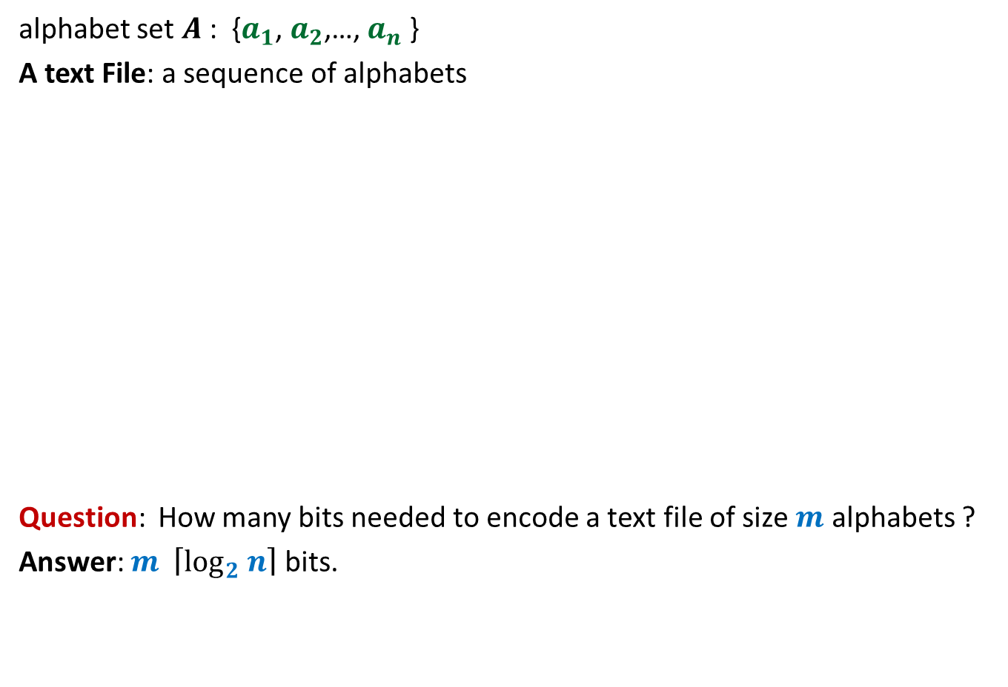
Binary coding
alphabet set $A$: {$a_{1}$, $a_{2}$,…, $a_{n}$ }
A text File: a sequence of alphabets
Question: How many bits needed to encode a text file of size $m$ alphabets ?
Answer: $m \left\lceil \log_{2} n\right\rceil$ bits.
once upon a time …………..
…………………………….
……………………………..
…………………
A text file F
Binary coding of F

Slide 15
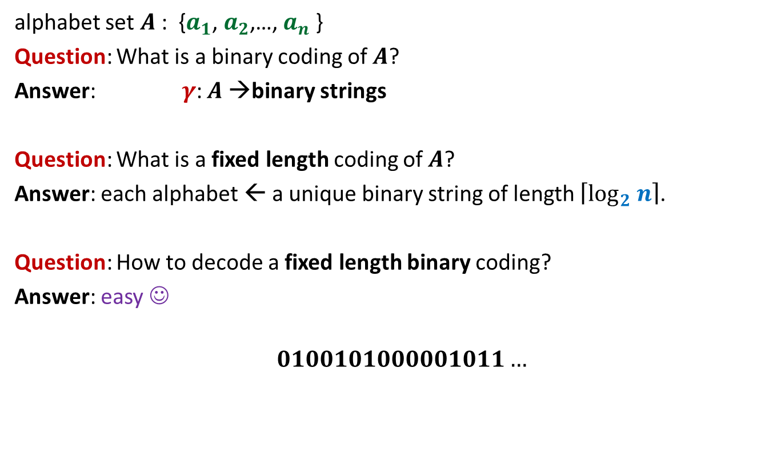
Fixed length coding
alphabet set $A$: {$a_{1}$, $a_{2}$,…, $a_{n}$ }
Question: What is a binary coding of $A$?
Answer: $γ$: $A$→binary strings
Question: What is a fixed length coding of $A$?
Answer: each alphabet ← a unique binary string of length $\left\lceil \log_{2} n\right\rceil$.
Question: How to decode a fixed length binary coding?
Answer: easy ☺
$$0100101000001011…$$

Slide 16
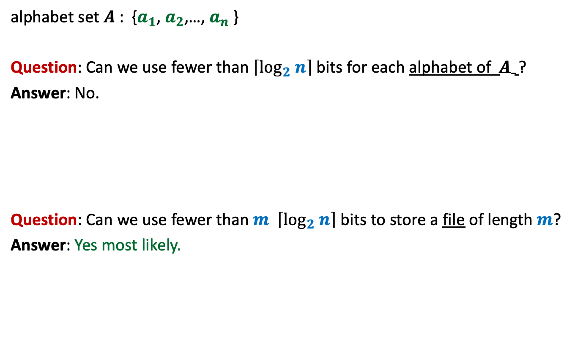
Fixed length coding
alphabet set $A$: {$a_{1}$, $a_{2}$,…, $a_{n}$ }
Question: Can we use fewer than $\left\lceil \log_{2} n\right\rceil$ bits for each alphabet of $A$ ?
Answer: No.
Question: Can we use fewer than $m \left\lceil \log_{2} n\right\rceil$ bits to store a file of length $m$?
Answer: Yes most likely.

Slide 17
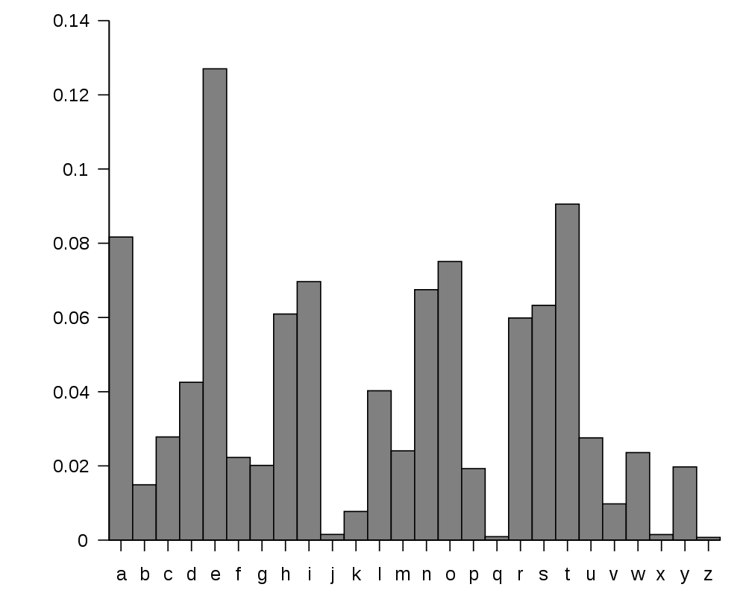
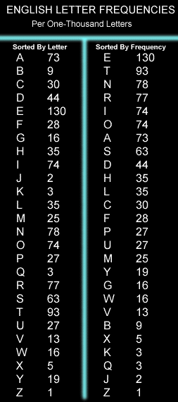
huge variation in the frequency of alphabets in a text.
http://en.wikipedia.org/wiki/Letter_frequency

Slide 18
huge variation in the frequency of alphabets in a text.
Question: How to exploit variation in the frequencies of alphabets ?
Answer:
More frequent alphabets ⬅ coding with shorter bit string
Less frequent alphabets ⬅ coding with longer bit string

Slide 19

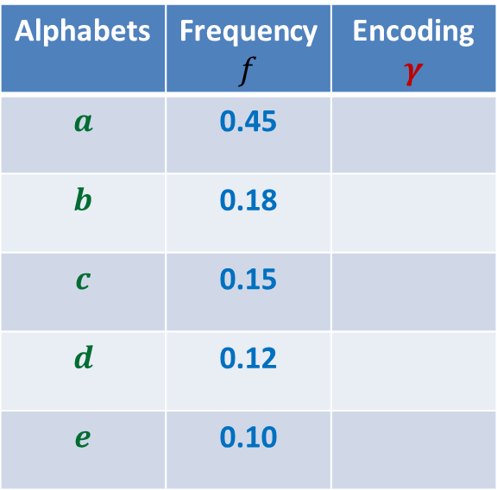

Variable length encoding
Let us think of some encoding exploiting
the variation in frequencies.
Average bit length per symbol using $γ$:
$$ABL\left(γ\right)=\sum_{x∈A}{f\left(x\right).\left|γ\left(x\right)\right|}$$
$=$ $0.45⨯1+0.18⨯2+(0.15+0.12+0.10)⨯3$
$=$ $1.92$
Question: How will you decode 01010111 ?
Answer: $abbe$ or $adae$
Question: What is the source of this ambiguity ?
Answer: $γ\left(b\right)$ is a prefix of $γ\left(d\right)$.
?
?
Alphabets | Frequency $f$ | Encoding $$γ$$
$$a$$ | 0.45
$$b$$ | 0.18
$$c$$ | 0.15
$$d$$ | 0.12
$$e$$ | 0.10
0
10
110
101
111
There is a serious problem with the $γ$encoding. Can you see?
Can we fix it ?

Slide 20

Variable length encoding
Average bit length per alphabet using $γ$:
$$ABL\left(γ\right)=\sum_{x∈A}{f\left(x\right).\left|γ\left(x\right)\right|}$$
$=$ $0.45⨯1+0.18⨯3+(0.15+0.12+0.10)⨯3$
$=$ $2.1$
Alphabets | Frequency $f$ | Encoding $$γ$$
$$a$$ | 0.45
$$b$$ | 0.18
$$c$$ | 0.15
$$d$$ | 0.12
$$e$$ | 0.10
0
100
110
101
111

Slide 21
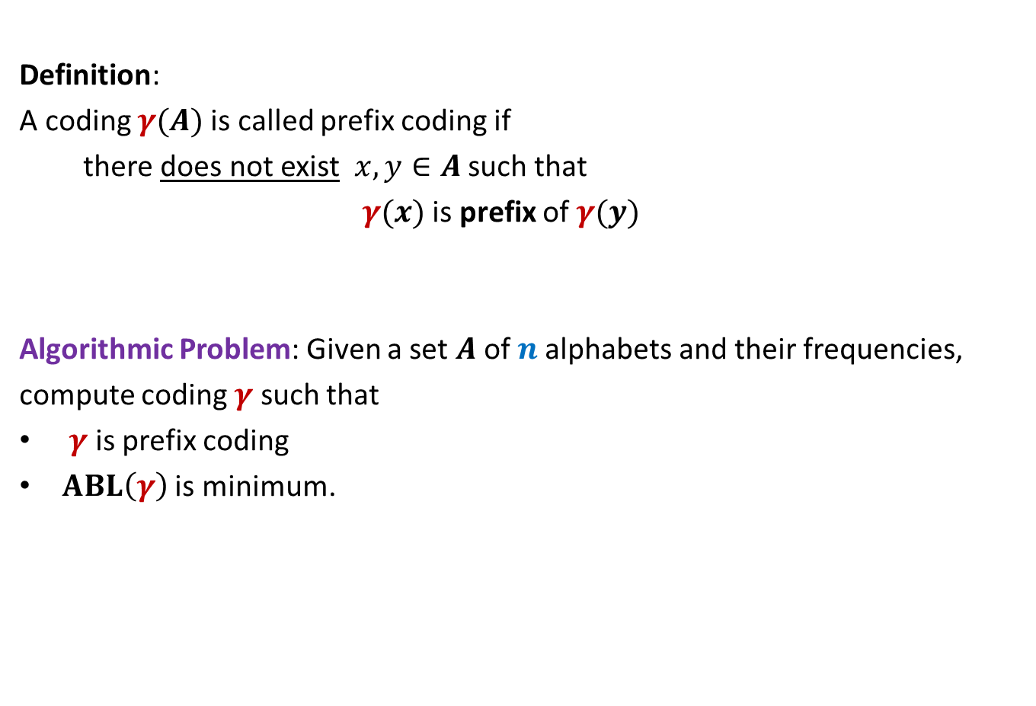
Prefix Coding
Definition:
A coding $γ(A)$is called prefix coding if
there does not exist $x,y∈A$ such that
$γ(x)$ is prefix of $γ(y)$
Algorithmic Problem: Given a set $A$of $n$alphabets and their frequencies,
compute coding $γ$ such that
$γ$ is prefix coding
$ABL\left(γ\right)$ is minimum.

Slide 22

The challenge of the problem
Among all possible binary coding of $A$, how to find the optimal prefix coding ?
It looks too complex ☹ because …
it is too difficult to see any structure underlying the set of binary strings

Slide 23
The novel idea of Huffman
?
0
1
0
1
0
1
Binary coding
Labeled
Binary tree

Slide 24
A labeled binary tree
nodes → ?
Code of an alphabet = ?
0
1
0,
00,
001
01,
1,
10,
100,
101
0
1
0
1
0
1
alphabets
Label of path from root

Slide 25
prefix codes and labeled Binary tree

Slide 26
A labeled binary tree
Consider a prefix code 101
0
1
1
0
Visualize a binary tree for the prefix code ?
0
1

Slide 27
A labeled binary tree
0
1
0
1
1
0
0
1
0
1
0
1
0
1

Slide 28
A labeled binary tree
leaf nodes → alphabets
Code of an alphabet =
0
1
01,
001,
0000,
11,
100,
10110,
10111
0
1
1
0
0
1
0
1
0
1
0
1
Label of path from root

Slide 29
Homework
Design an algorithm that given a prefix coding for a set of alphabets, builds the corresponding labeled binary tree.
The algorithm is sketched on the following slide.

Slide 30

Prefix Coding
Question:
How to build the labeled tree for a prefix code ?
Alphabets | Frequency $f$ | Encoding $$γ$$
$$a$$ | 0.45
$$b$$ | 0.18
$$c$$ | 0.15
$$d$$ | 0.12
$$e$$ | 0.10
0
{0, 100, 101, 110, 111}
0
1
100
110
{00,01,10,11}
$$a$$
101
111

Slide 31
Prefix Coding
Question:
How to build the labeled tree for a prefix code ?
Alphabets | Frequency $f$ | Encoding $$γ$$
$$a$$ | 0.45
$$b$$ | 0.18
$$c$$ | 0.15
$$d$$ | 0.12
$$e$$ | 0.10
0
0
1
100
110
0
1
$$a$$
101
{0,1}
{0,1}
111

Slide 32




Prefix Coding
Question:
How to build the labeled tree for a prefix code ?
Alphabets | Frequency $f$ | Encoding $$γ$$
$$a$$ | 0.45
$$b$$ | 0.18
$$c$$ | 0.15
$$d$$ | 0.12
$$e$$ | 0.10
0
0
1
100
110
0
1
$$a$$
101
0
1
0
1
111
$$b$$
$$d$$
$$c$$
$$e$$

Slide 33
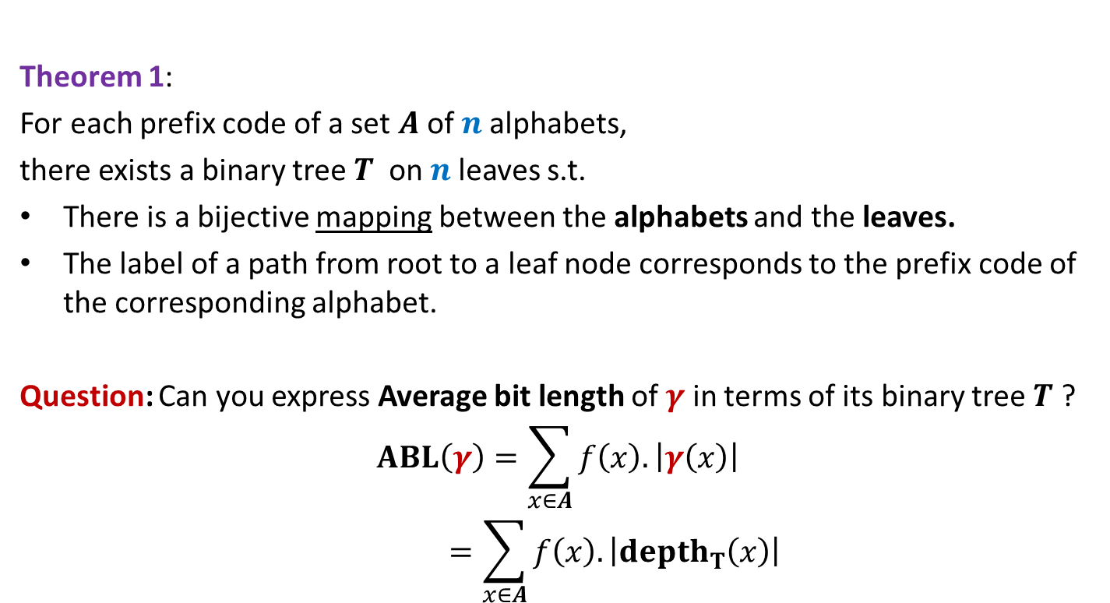
Theorem 1:
For each prefix code of a set $A$of $n$alphabets,
there exists a binary tree$T$ on $n$leaves s.t.
There is a bijective mapping between the alphabets and the leaves.
The label of a path from root to a leaf node corresponds to the prefix code of the corresponding alphabet.
Question: Can you express Average bit length of $γ$ in terms of its binary tree $T$ ?
$$ABL\left(γ\right)=\sum_{x∈A}{f\left(x\right).\left|γ\left(x\right)\right|}$$
$$=\sum_{x∈A}{f\left(x\right).\left|depth_{T}\left(x\right)\right|}$$

Slide 34
Finding the labeled binary tree for
the optimal prefix codes

Slide 35
Is the following prefix coding optimal ?
full binary tree
0
1
0
1
1
0
0
1
0
1
0
1
0
1

Slide 36


Observations on the binary tree of the optimal prefix code
Lemma:
The binary tree corresponding to optimal prefix coding must be a full binary tree:
Every internal node has degree exactly 2.
Question: What next ?
We need to see the influence of frequencies on the optimal binary tree.
Non-decreasing order of frequency
$${f(a}_{i})≤{f(a}_{i+1})$$
$a_{1}$ , $a_{2}$ , … , $a_{n}$

Slide 37
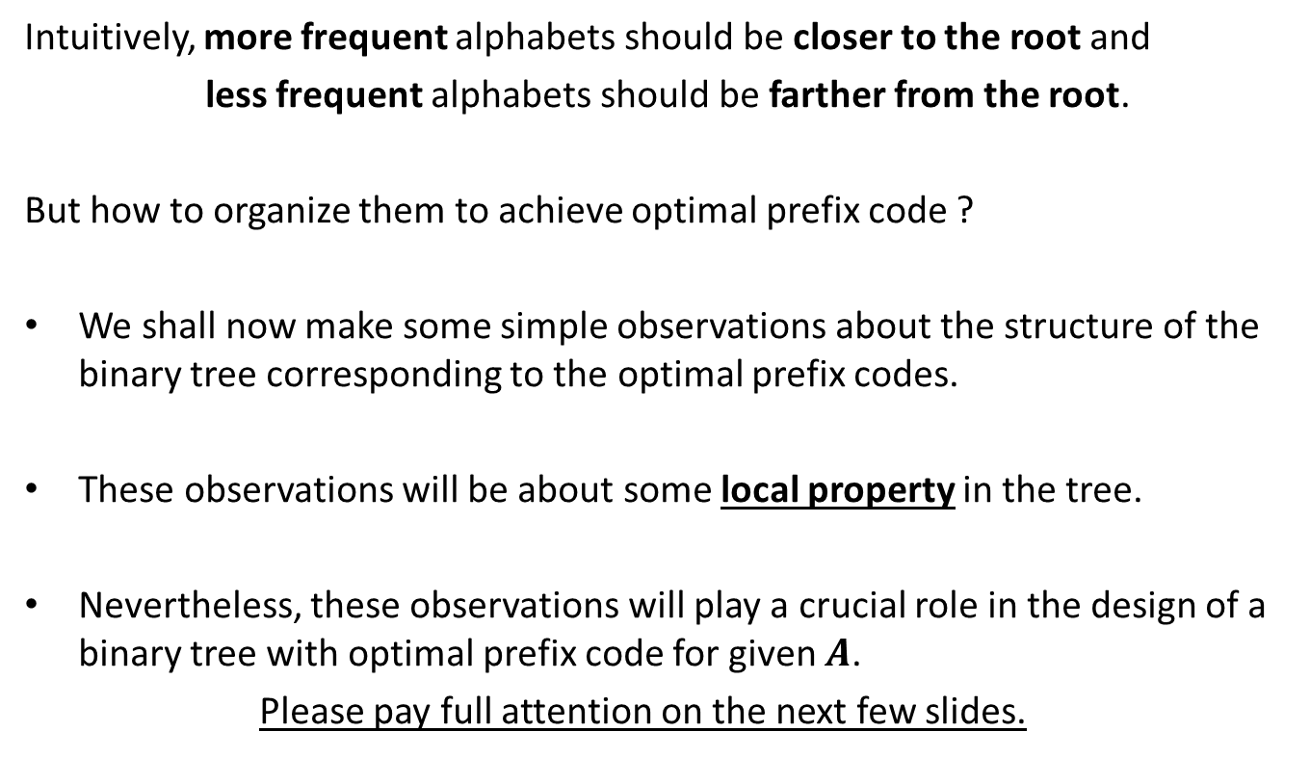
Observations on the binary tree of the optimal prefix code
Intuitively, more frequent alphabets should be closer to the root and
less frequent alphabets should be farther from the root.
But how to organize them to achieve optimal prefix code ?
We shall now make some simple observations about the structure of the binary tree corresponding to the optimal prefix codes.
These observations will be about some local property in the tree.
Nevertheless, these observations will play a crucial role in the design of a binary tree with optimal prefix code for given $A$.
Please pay full attention on the next few slides.

Slide 38

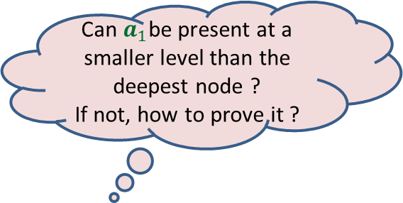

More Observations
Can $a_{1}$be present at a smaller level than the deepest node ?
If not, how to prove it ?
0
1
0
1
0
1
. . .
0
1
0
$$a_{1}$$
Deepest level
$$a_{i}$$

Slide 39


More Observations
0
1
1
Swapping $a_{1}$ with $a_{i}$ can not increase ABL.
0
1
0
. . .
0
1
0
$$a_{1}$$
Deepest level
$$a_{i}$$

Slide 40

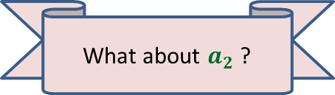

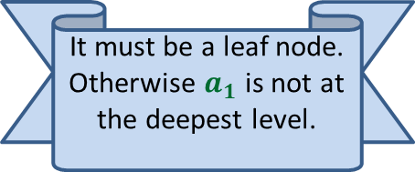


More Observations
0
1
Since the tree is full binary, $a_{1}$ must have a sibling. What can we say about it ?
1
Swapping $a_{2}$ with $a_{i}$ can not increase ABL.
0
1
0
It must be a leaf node. Otherwise $a_{1}$ is not at the deepest level.
. . .
What about $a_{2}$ ?
0
1
$$a_{2}$$
0
1
Deepest level
$$a_{1}$$
$$a_{i}$$

Slide 41
More Observations
0
1
0
1
0
1
. . .
0
1
$$a_{2}$$
0
1
Deepest level
$$a_{1}$$
$$a_{i}$$

Slide 42
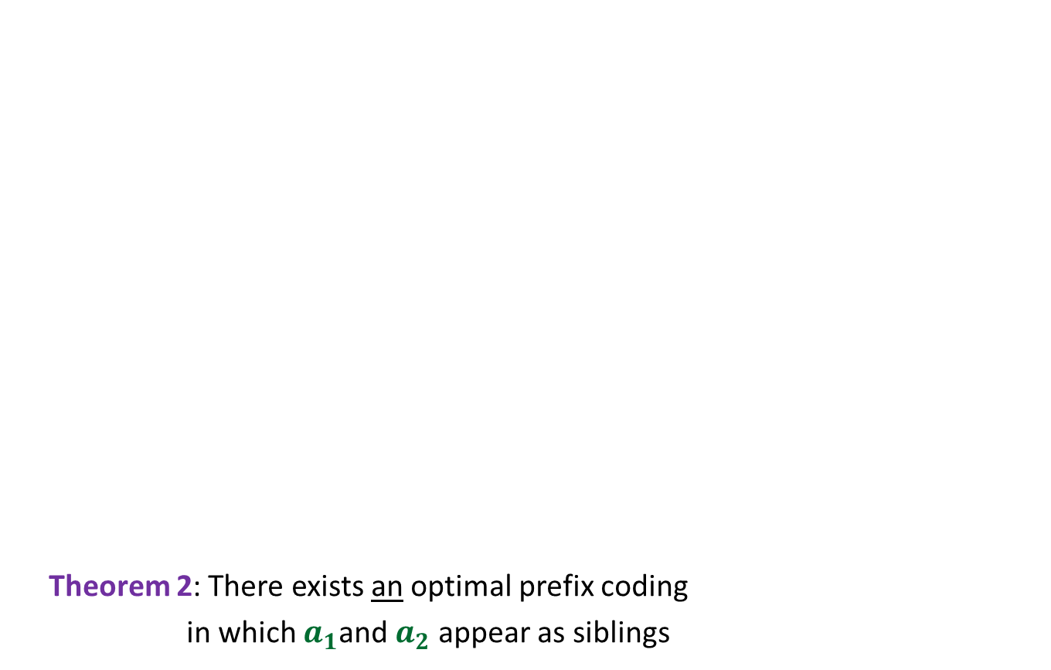

More Observations
0
1
Theorem 2: There exists an optimal prefix coding
in which $a_{1}$and $a_{2}$ appear as siblings
0
1
0
1
. . .
1
0
1
Deepest level
$$a_{1}$$
$$a_{2}$$

Slide 43
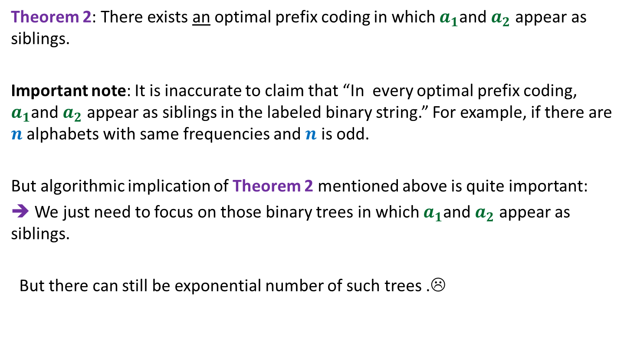
The important observation
Theorem 2: There exists an optimal prefix coding in which $a_{1}$and $a_{2}$ appear as siblings.
Important note: It is inaccurate to claim that “In every optimal prefix coding, $a_{1}$and $a_{2}$ appear as siblings in the labeled binary string.” For example, if there are $n$ alphabets with same frequencies and $n$ is odd.
But algorithmic implication of Theorem 2 mentioned above is quite important:
➔ We just need to focus on those binary trees in which $a_{1}$and $a_{2}$ appear as siblings.
But there can still be exponential number of such trees .☹

Slide 44
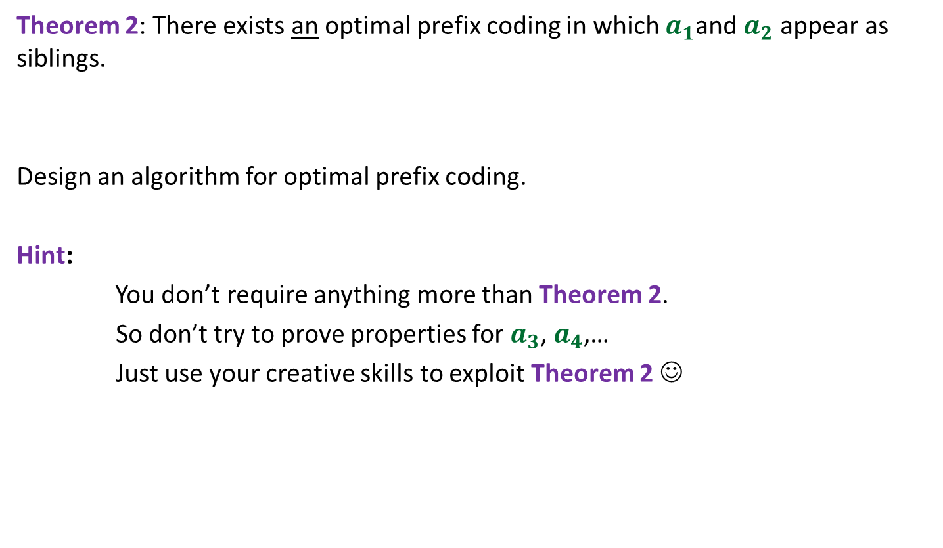
Homework
Theorem 2: There exists an optimal prefix coding in which $a_{1}$and $a_{2}$ appear as siblings.
Design an algorithm for optimal prefix coding.
Hint:
You don’t require anything more than Theorem 2.
So don’t try to prove properties for $a_{3}$, $a_{4}$,…
Just use your creative skills to exploit Theorem 2 ☺

